Slide 1
CS591 Compressed Sensing
Vugar Javadov, Songbo Wu, Haoyu Zhang

Slide 2
How to separate voice and background music in a song?

Slide 3
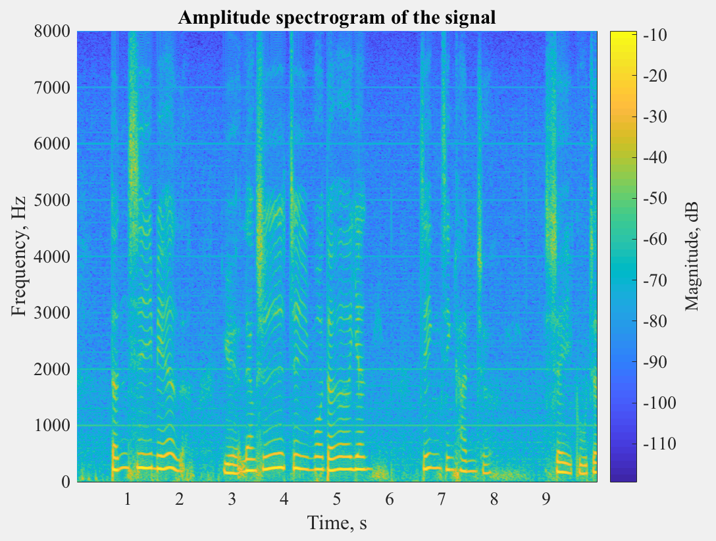
Sparsity of singing voice
Short Time Fourier Transformation
Human voice is sparse in both time and frequency domain.
STFT of sing voice is sparse matrix!

Slide 4
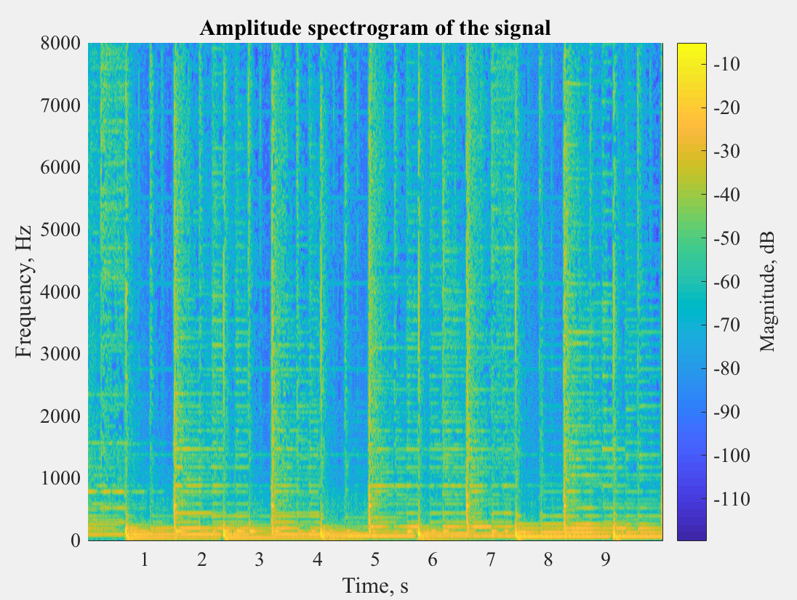
Low-rank of Music
Short Time Fourier Transformation
Music has a repeating structure
STFT of music has low-rank!

Slide 5
Robust SVD
So by the assumption that music has low-rank and human voice is sparse. We tried to solve the following problem:
minimize ||L||∗ + λ||S||₁
subject to L+S=M
[1] Singing-voice separation from monaural recordings using robust principal component analysis, 2012

Slide 6
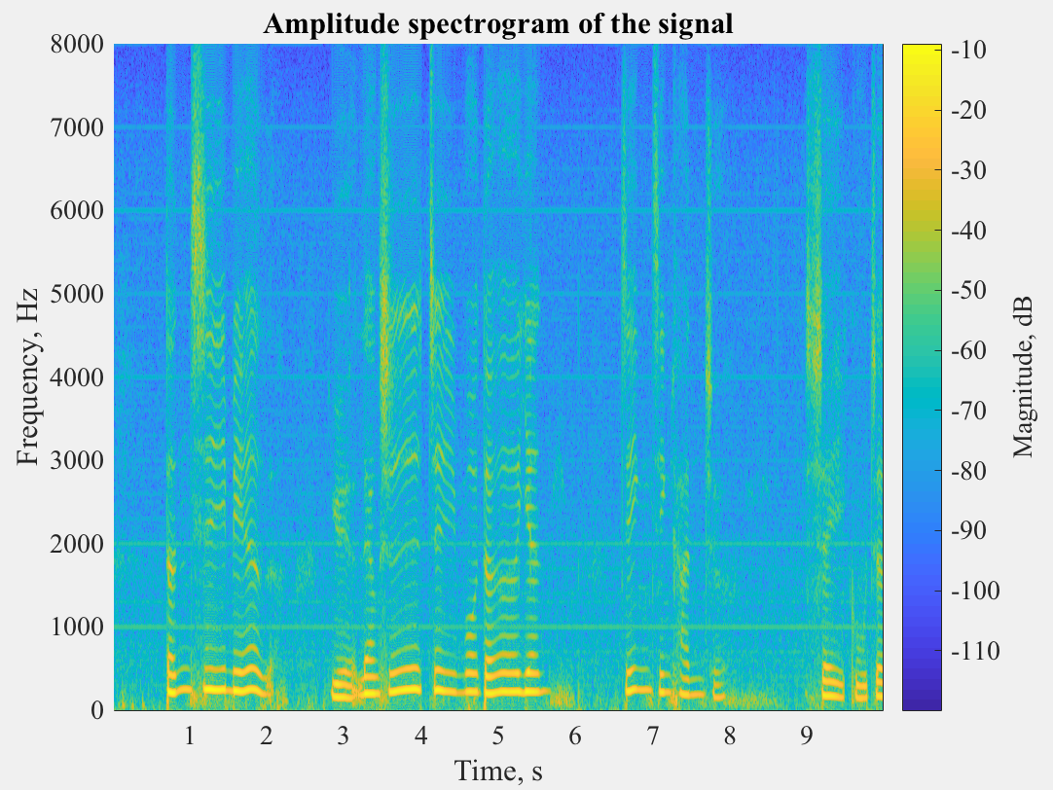
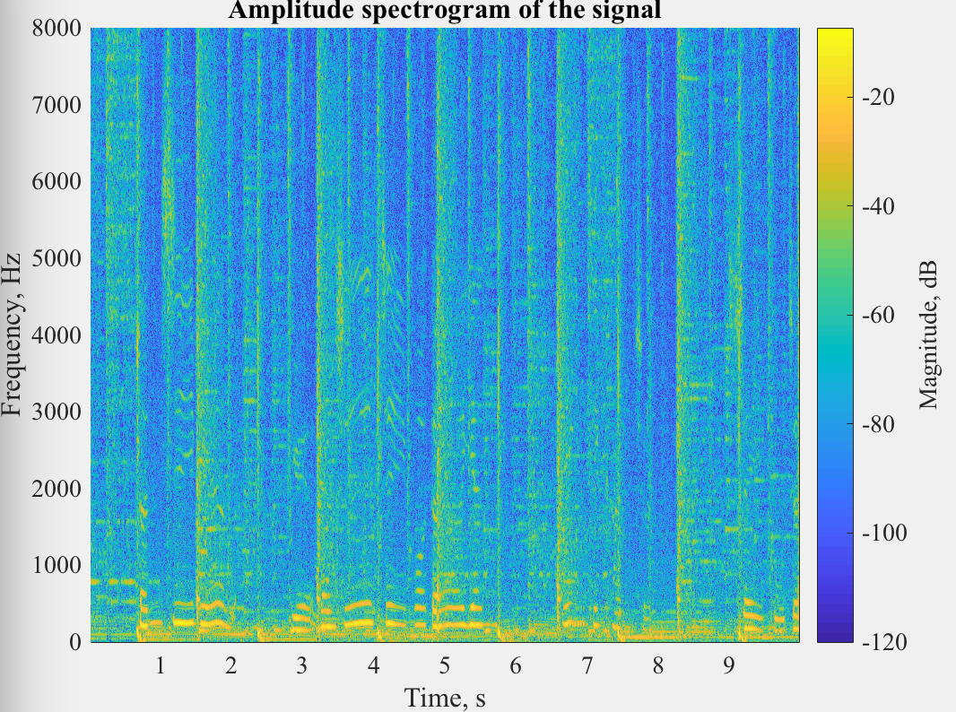
Robust SVD
Some result when λ = 0.011:
original singing voice recovered
[1] Singing-voice separation from monaural recordings using robust principal component analysis, 2012

Slide 7
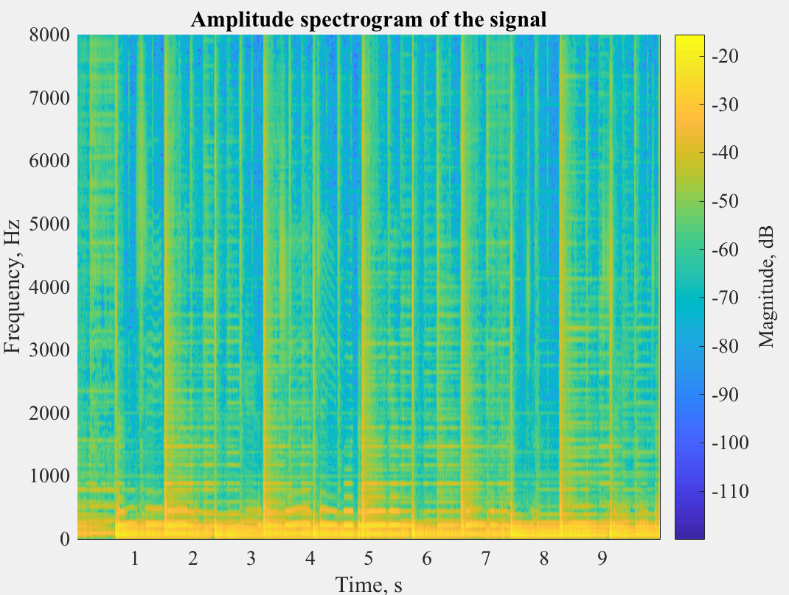
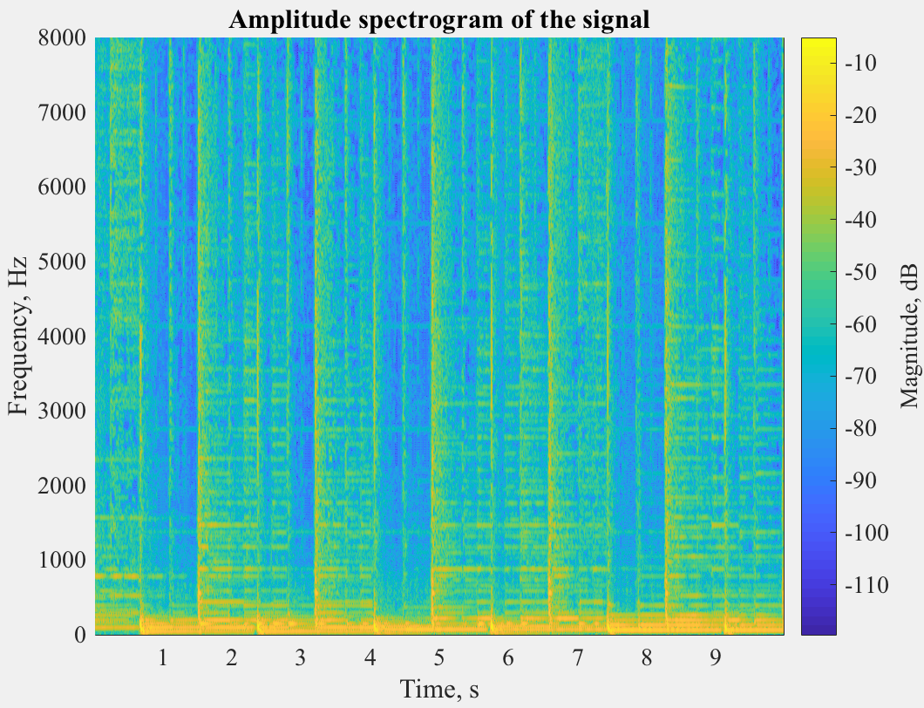
Robust SVD
Some result when λ = 0.011:
original music recovered
[1] Singing-voice separation from monaural recordings using robust principal component analysis, 2012

Slide 8
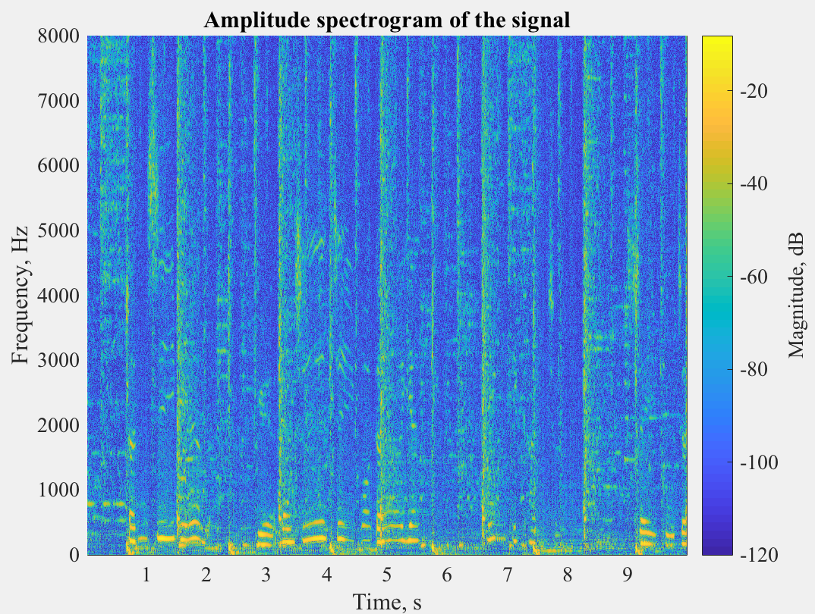
Robust SVD
Some result when λ = 0.016:
original singing voice recovered
[1] Singing-voice separation from monaural recordings using robust principal component analysis, 2012

Slide 9
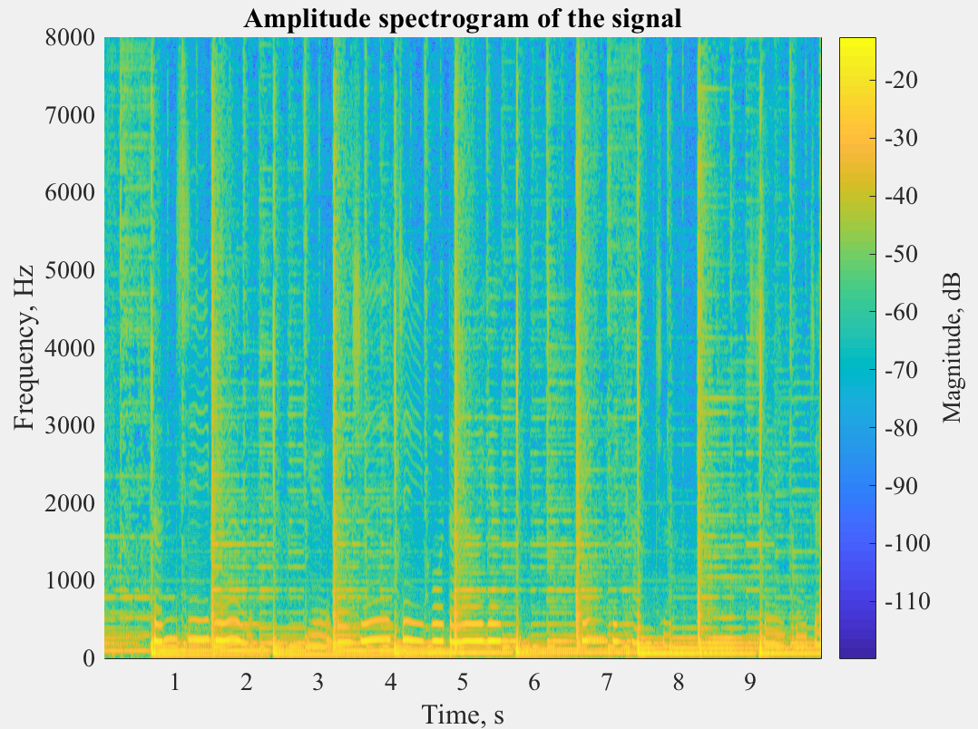
Robust SVD
Some result when λ = 0.016:
original music recovered
[1] Singing-voice separation from monaural recordings using robust principal component analysis, 2012

Slide 10
Difficulties

Slide 11
Robust SVD
Pros
Simple to implement
It works, but not perfect
Cons
Choose a suitable λ is hard. When λ is smaller it performs better in high frequency. When λ is bigger it performs better in low frequency
The algorithm gets good singing voice, but the output music is not good
No representation of noise

Slide 12
Unsupervised
vs
Supervised

Slide 13
WIP - Dictionary Learning
Pros
Totally based on dataset
We don’t need to tune those parameters anymore
Cons
Computational expensiveness
Local minimal

Slide 14
WIP - Dictionary Learning
Using dictionary learning to find the sparse representation and recover the signal. By solving the following minimization problem:
E = minimize ||S₁||₁ + λ||S₂||₁ + α||M - D₁S₁ - D₂S₂||₂

Slide 15
WIP - Dictionary Learning
Method:
Step 1: Minimize E with respect to S₁ and S₂ for current D₁ and D₂.
Step 2: Minimize E with respect to D₁ and D₂ using gradient descent.
…
We are still working on this method! :)

Slide 16
Thank you !

